Slide 1



Machine learning como ferramenta auxiliar à química computacional
XXII Simpósio Brasileiro de Química Teórica
Dr. Henrique de Castro Silva Junior

Slide 2
Machine learning as an auxiliary tool for computational chemistry
XXII Brazilian Symposium on Theoretical Chemistry
Dr. Henrique de Castro Silva Junior

Slide 3
What is this workshop about? What to expect?
BUT you wil receive links to get all the code and you can even follow along if you want! 😉
NOT a hands-on experience
BUT it will not hurt if you know some python (or any other programming language)! 😉
NO coding skills necessary
Basic theory,
Options,
Pitfalls,
Organic/Inorganic
More like a “what you need to know before you start”
(With examples)

Slide 4


What to install/use?
Remote: Google Collab
Local: anaconda, Visual Studio Code, Jupyter/Lab
conda create –n py310w python=3.10
conda activate py310w
pip install rdkit dscribe tensorflow pycaret jupyterlab jupyter pandas numpy gensim xgboost
https://drive.google.com/drive/folders/1ifk8KFn_iJ1hNtRx3WBJtBr11h_iKuXq?usp=sharing
https://github.com/HenriqueCSJ/SBQT2023

Slide 5



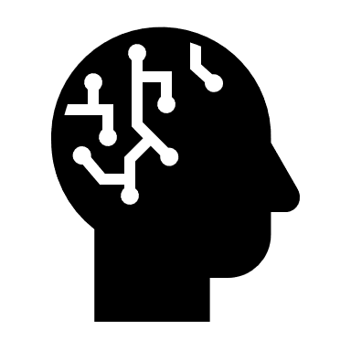

Day 1
History & Introduction
Day 2
Dealing with molecules
Day 3
Datasets & RF & XGBoost
Day 4
Deep Learning & Neural Networks
Day 5
From Start to Finish: One Model

Slide 6
Day 1 History & Introduction

Slide 7

History
Alan Turing publishes “Computing Machinery and Intelligence”
1950

Slide 8
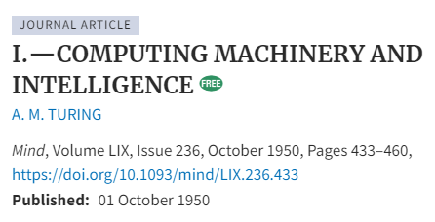
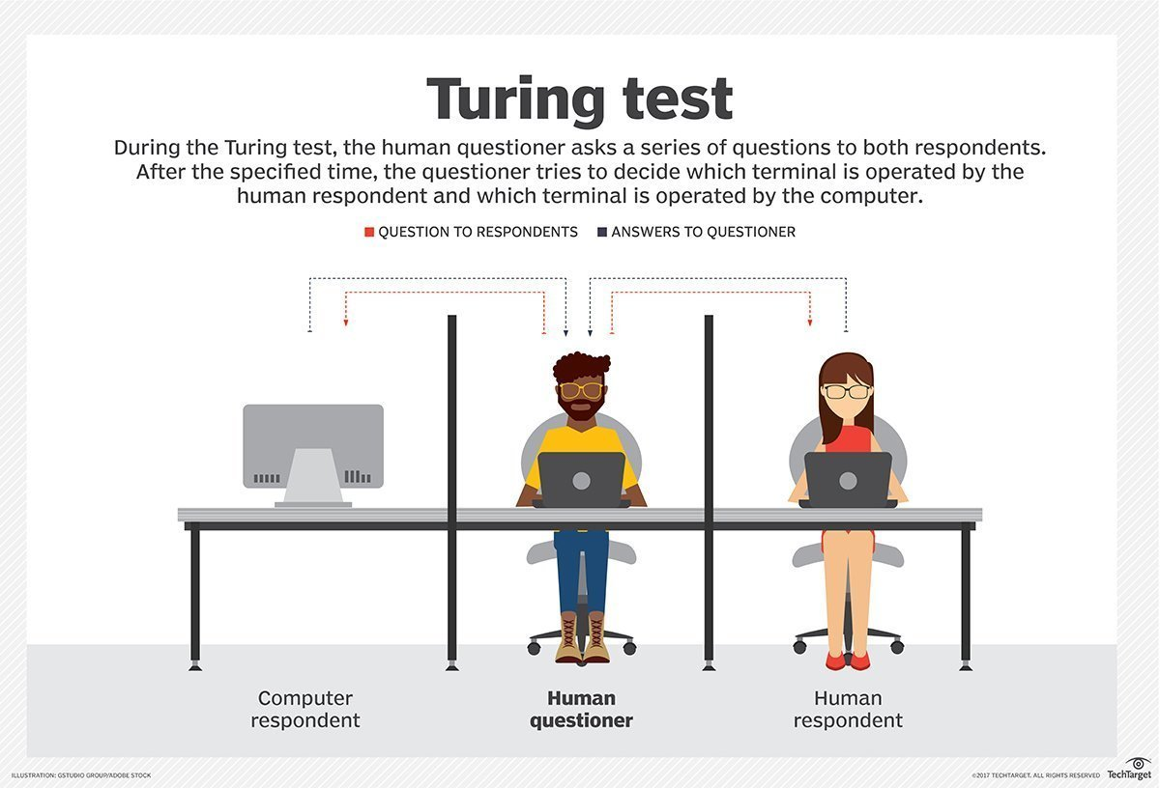

Alan Mathison Turing
(23 June 1912 – 7 June 1954)

Slide 9

History
Alan Turing publishes “Computing Machinery and Intelligence”
1950
1952
The first program for playing checkers, written by Arthur Samuel

Slide 10
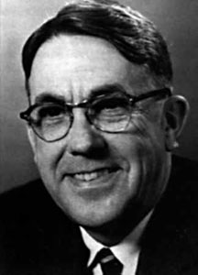
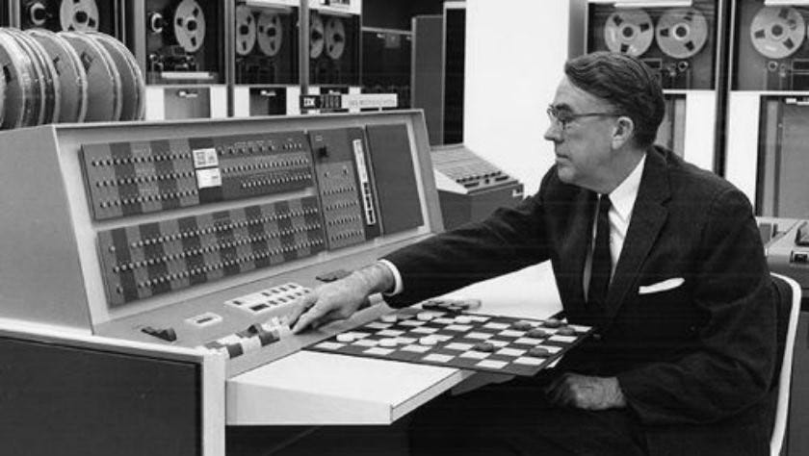
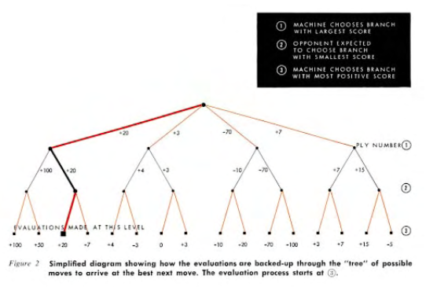
Arthur Lee Samuel
(December 5, 1901 – July 29, 1990)

Slide 11
History
Alan Turing publishes “Computing Machinery and Intelligence”
First neural network for computers the Perceptron, by Frank Rosenblatt
1950
1952
1957
The first program for playing checkers, written by Arthur Samuel

Slide 12
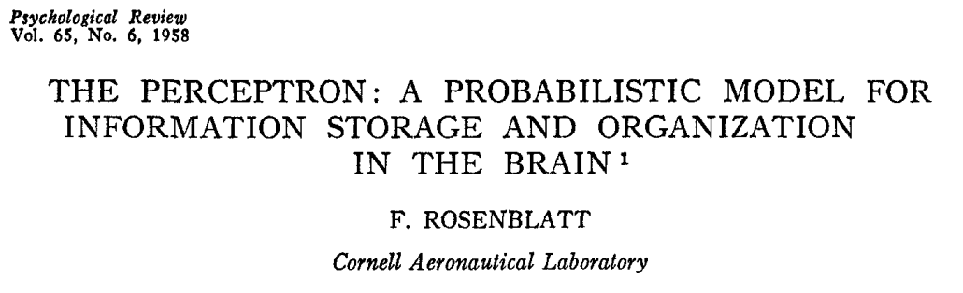
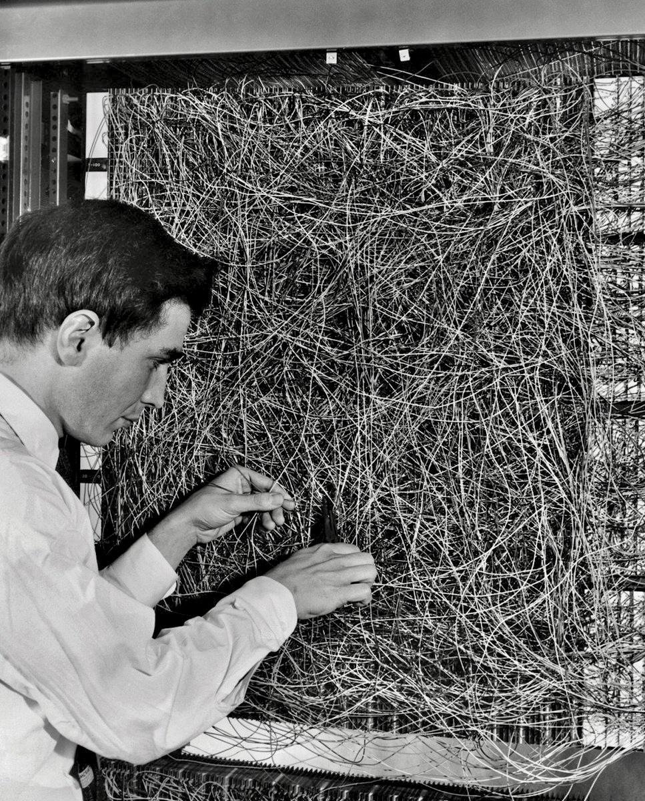
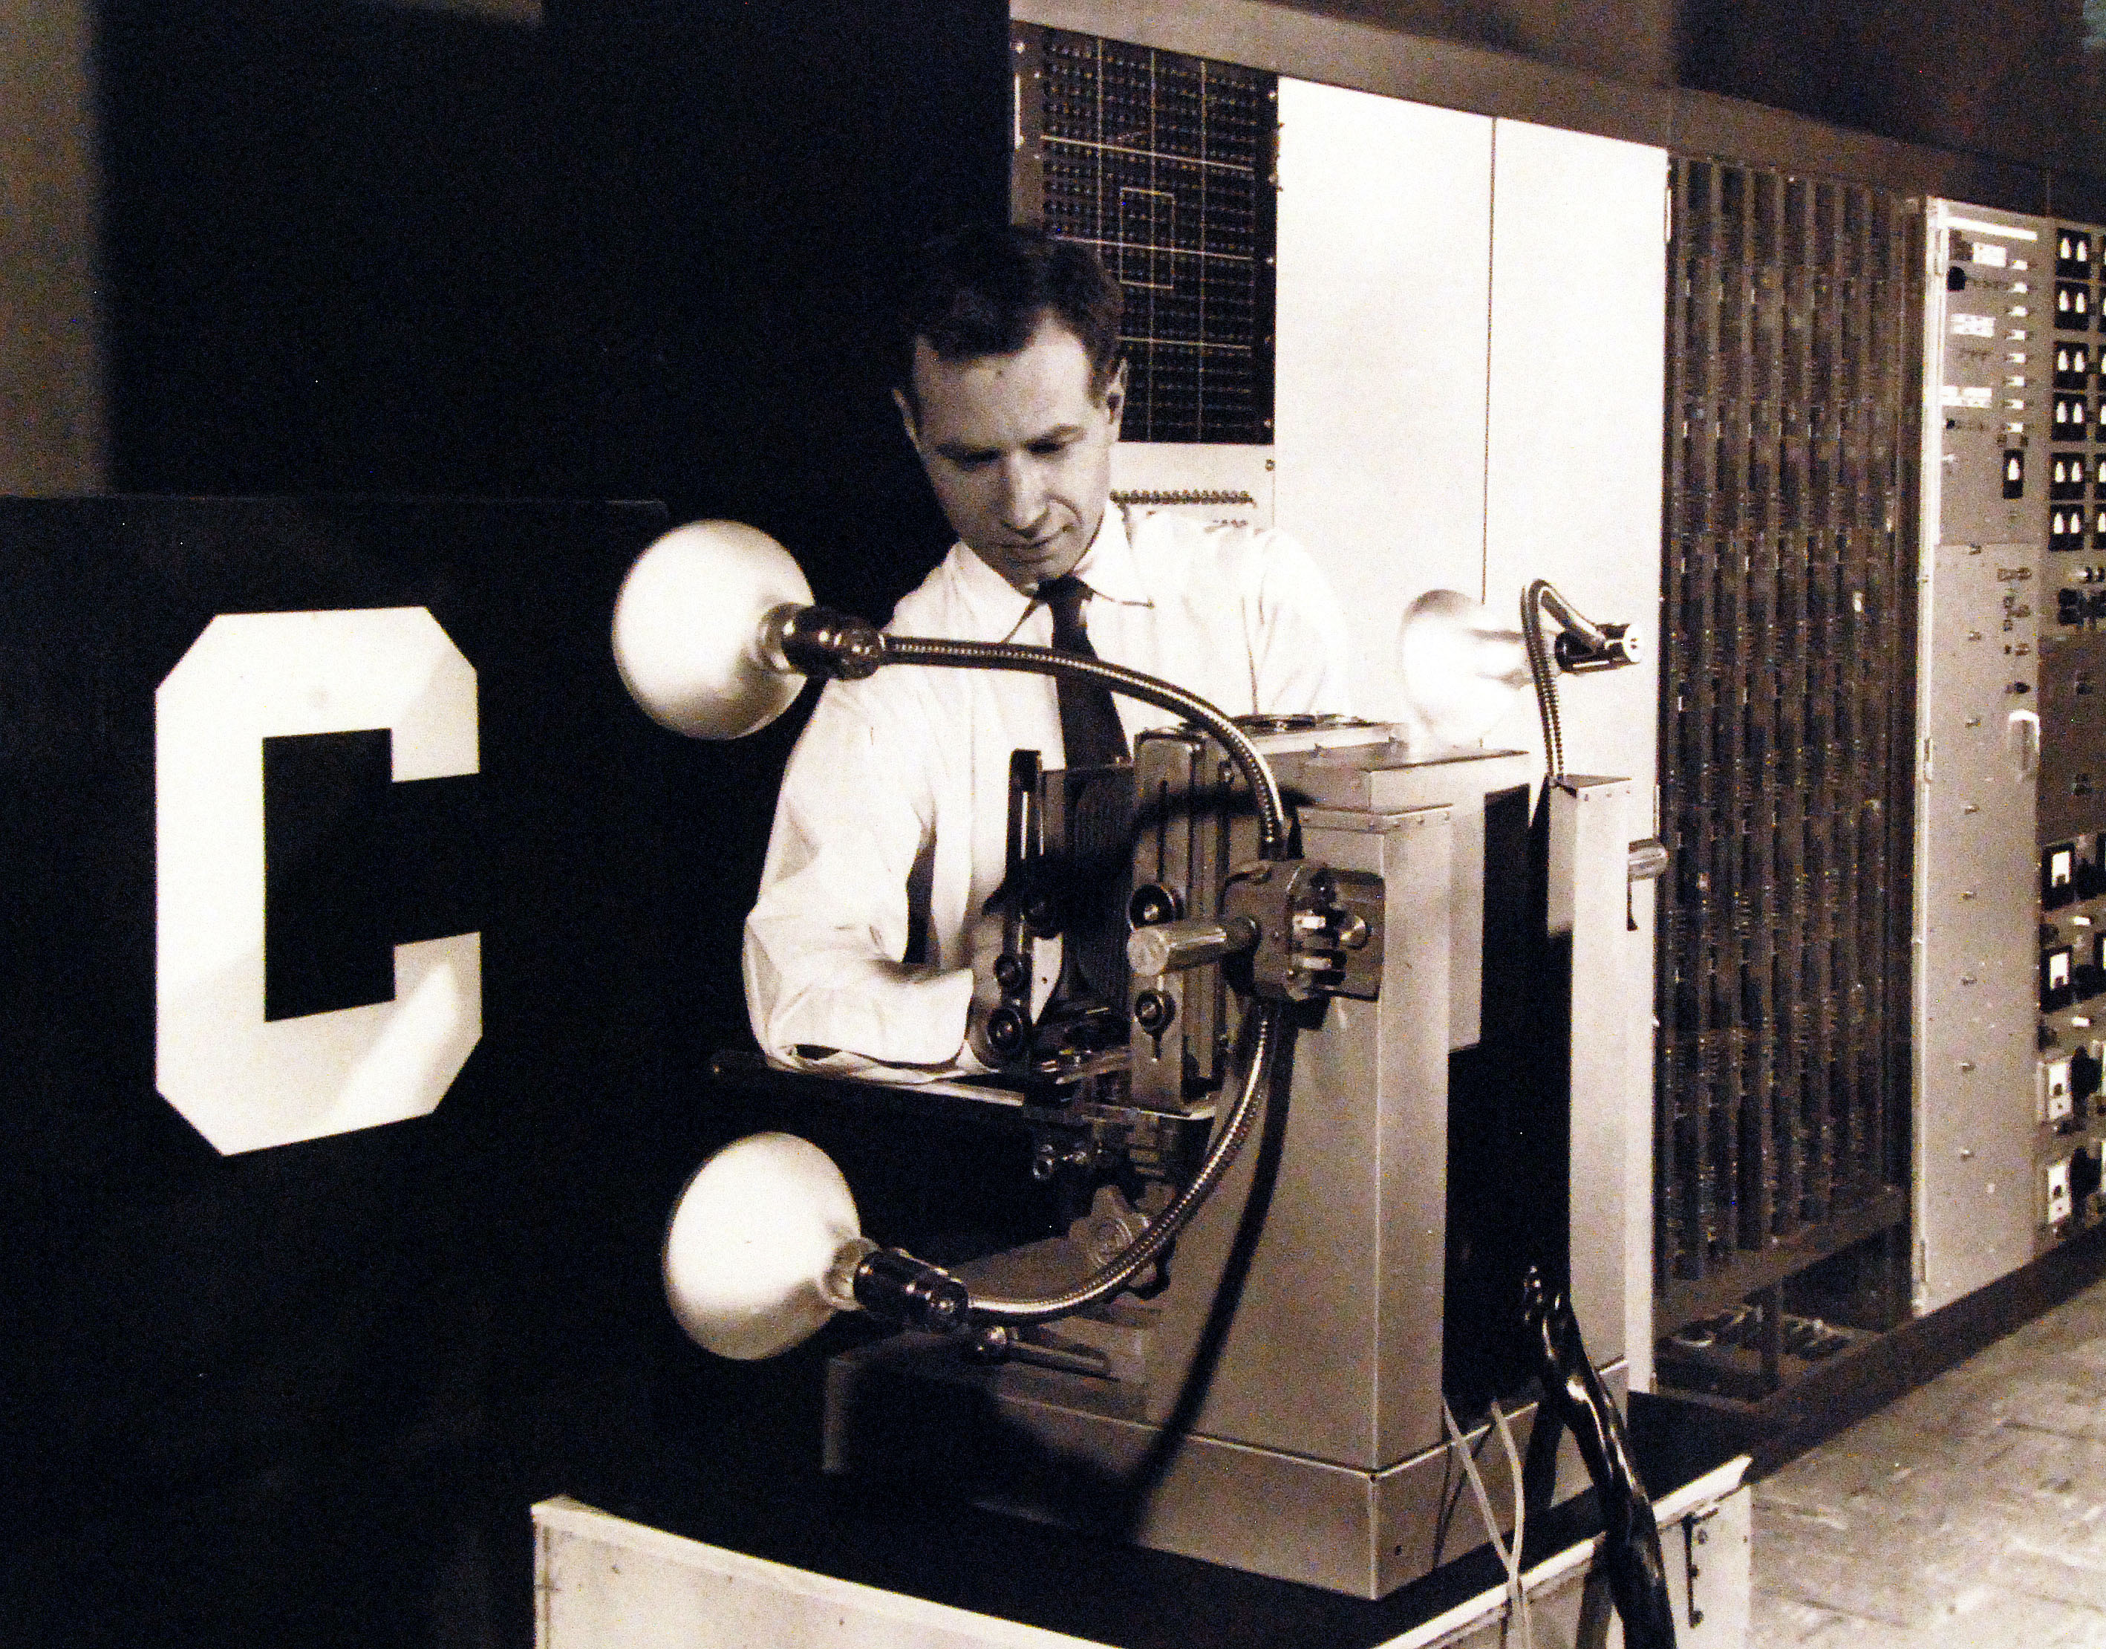
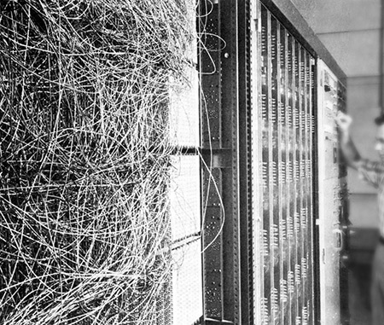
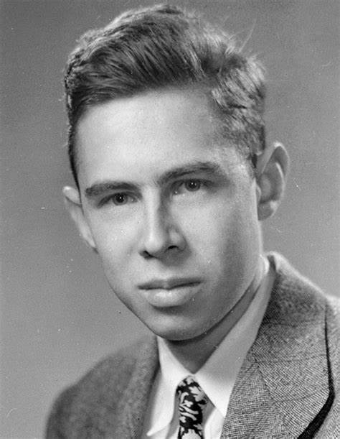
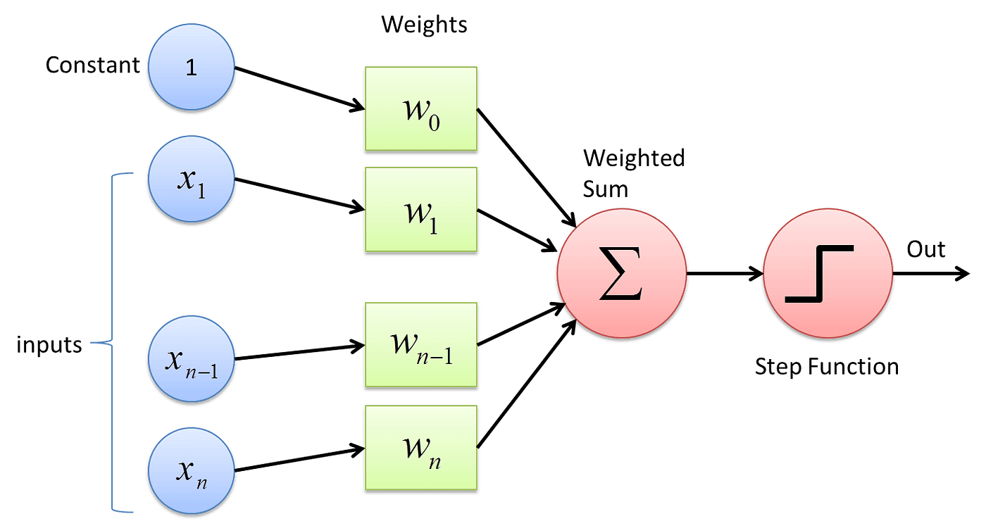
20×20 cadmium sulfide photocells to make a 400-pixel image
Frank Rosenblatt
(July 11, 1928 – July 11, 1971)
Potentiometers

Slide 13
Frank Rosenblatt
(July 11, 1928 – July 11, 1971)

Slide 14

History
Alan Turing publishes “Computing Machinery and Intelligence”
First neural network for computers the Perceptron, by Frank Rosenblatt
1950
1952
1957
1967
The first program for playing checkers, written by Arthur Samuel
The nearest Neighbor algorithm was written by the Chinese

Slide 15
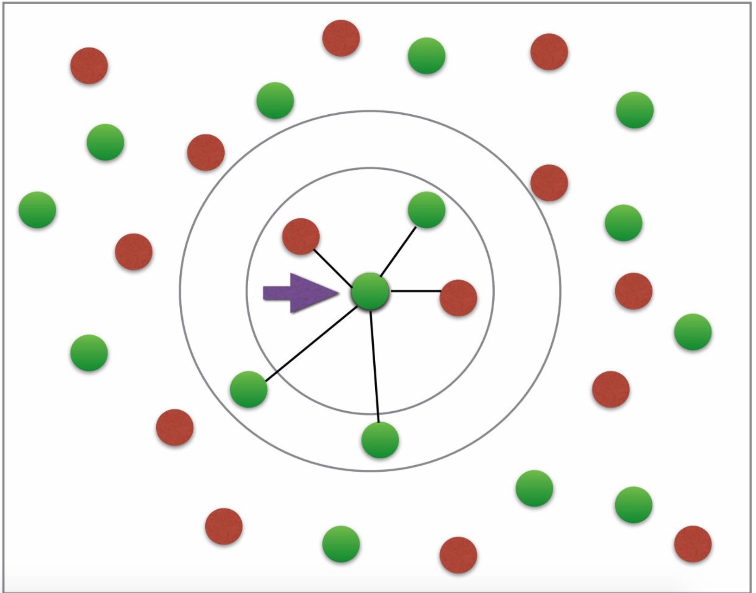
Initialize all vertices as unvisited.
Select an arbitrary vertex, set it as the current vertex u. Mark u as visited.
Find out the shortest edge connecting the current vertex u and an unvisited vertex v.
Set v as the current vertex u. Mark v as visited.
If all the vertices in the domain are visited, then terminate. Else, go to step 3.

Slide 16
History
Alan Turing publishes “Computing Machinery and Intelligence”
First neural network for computers the Perceptron, by Frank Rosenblatt
The first computer-controlled autonomous vehicle, Stanford Cart, was built
1950
1952
1957
1967
1979
The first program for playing checkers, written by Arthur Samuel
The nearest Neighbor algorithm was written by the Chinese

Slide 17
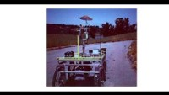
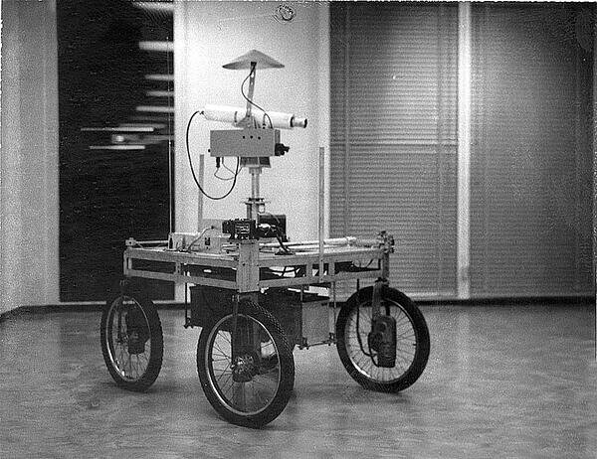

Slide 18

History
Alan Turing publishes “Computing Machinery and Intelligence”
First neural network for computers the Perceptron, by Frank Rosenblatt
The first computer-controlled autonomous vehicle, Stanford Cart, was built
1950
1952
1957
1967
1979
1997
The first program for playing checkers, written by Arthur Samuel
The nearest Neighbor algorithm was written by the Chinese
IBM’s Deep Blue became the first computer chess-playing system to beat a reigning world chess champion, Garry Kasparov

Slide 19
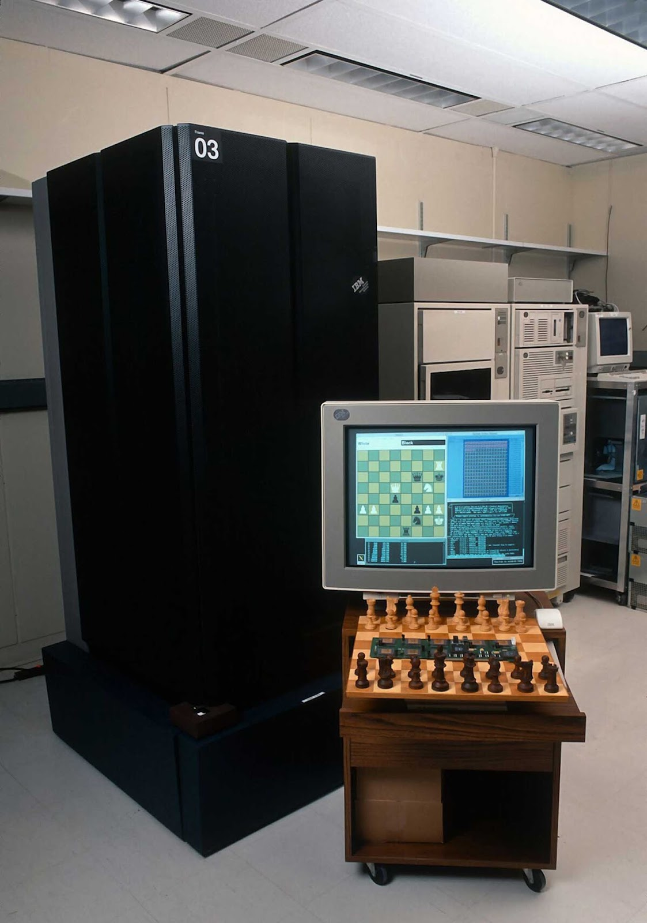
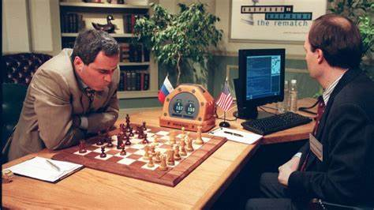
In 1996, Kasparov won the match by a score of 4–2. He lost the first game, but then won three and drew two of the following five games.
In 1997, Deep Blue won the rematch by a score of 3½–2½. It was the first computer to defeat a reigning world chess champion in a match under tournament conditions

Slide 20

History
Alan Turing publishes “Computing Machinery and Intelligence”
First neural network for computers the Perceptron, by Frank Rosenblatt
The first computer-controlled autonomous vehicle, Stanford Cart, was built
The Machine Learning software library Torch is first released
1950
1952
1957
1967
1979
1997
2002
The first program for playing checkers, written by Arthur Samuel
The nearest Neighbor algorithm was written by the Chinese
IBM’s Deep Blue became the first computer chess-playing system to beat a reigning world chess champion, Garry Kasparov

Slide 21


2017

Slide 22

History
Alan Turing publishes “Computing Machinery and Intelligence”
First neural network for computers the Perceptron, by Frank Rosenblatt
The first computer-controlled autonomous vehicle, Stanford Cart, was built
The Machine Learning software library Torch is first released
1950
1952
1957
1967
1979
1997
2002
2016
The first program for playing checkers, written by Arthur Samuel
The nearest Neighbor algorithm was written by the Chinese
IBM’s Deep Blue became the first computer chess-playing system to beat a reigning world chess champion, Garry Kasparov
Google’s AlphaGo defeated Lee Sedol, one of the best Go players in the world, in a five-game match

Slide 23
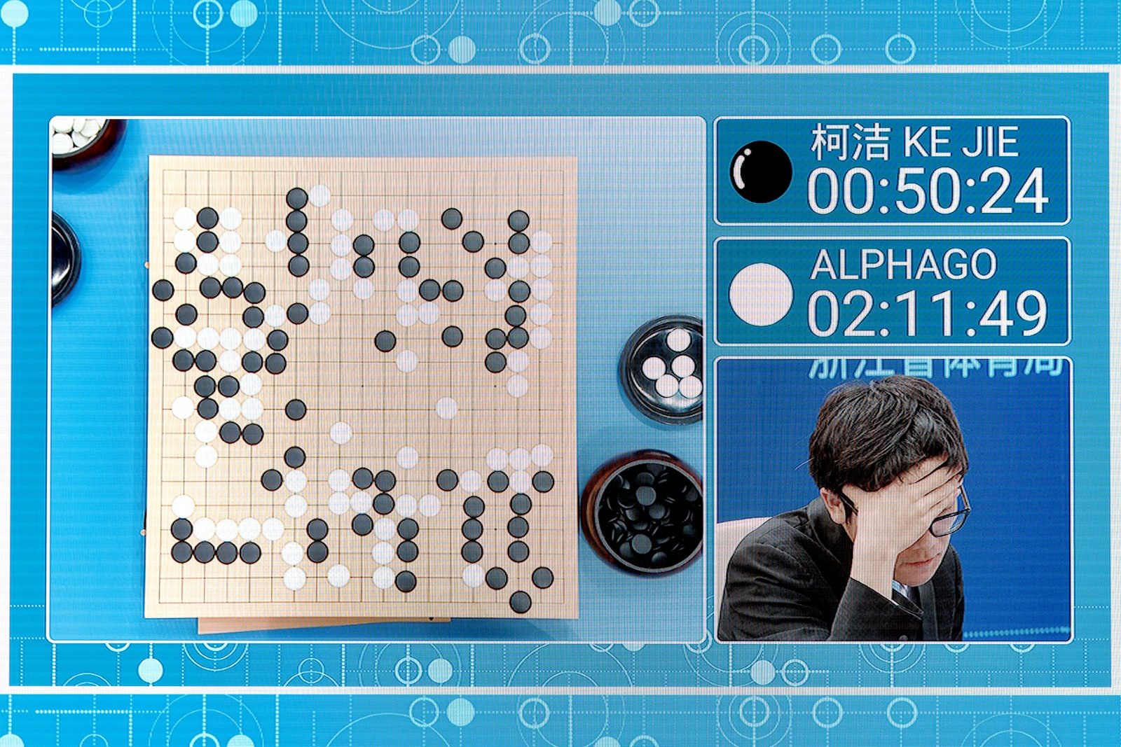


Slide 24
History
1950
1952
1957
1967
1979
1997
2002
2016
Alan Turing publishes “Computing Machinery and Intelligence”
First neural network for computers the Perceptron, by Frank Rosenblatt
The first computer-controlled autonomous vehicle, Stanford Cart, was built
The Machine Learning software library Torch is first released
The first program for playing checkers, written by Arthur Samuel
The nearest Neighbor algorithm was written by the Chinese
IBM’s Deep Blue became the first computer chess-playing system to beat a reigning world chess champion, Garry Kasparov
Google’s AlphaGo defeated Lee Sedol, one of the best Go players in the world, in a five-game match

Slide 25

History
Alan Turing publishes “Computing Machinery and Intelligence”
First neural network for computers the Perceptron, by Frank Rosenblatt
The first computer-controlled autonomous vehicle, Stanford Cart, was built
The Machine Learning software library Torch is first released
DeepMind’s AlphaFold solved the protein-folding problem
1950
1952
1957
1967
1979
1997
2002
2016
2020
The first program for playing checkers, written by Arthur Samuel
The nearest Neighbor algorithm was written by the Chinese
IBM’s Deep Blue became the first computer chess-playing system to beat a reigning world chess champion, Garry Kasparov
Google’s AlphaGo defeated Lee Sedol, one of the best Go players in the world, in a five-game match

Slide 26
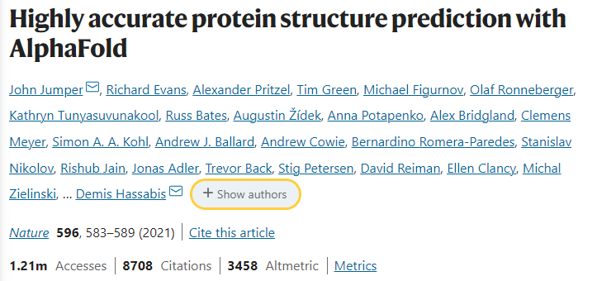
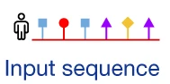
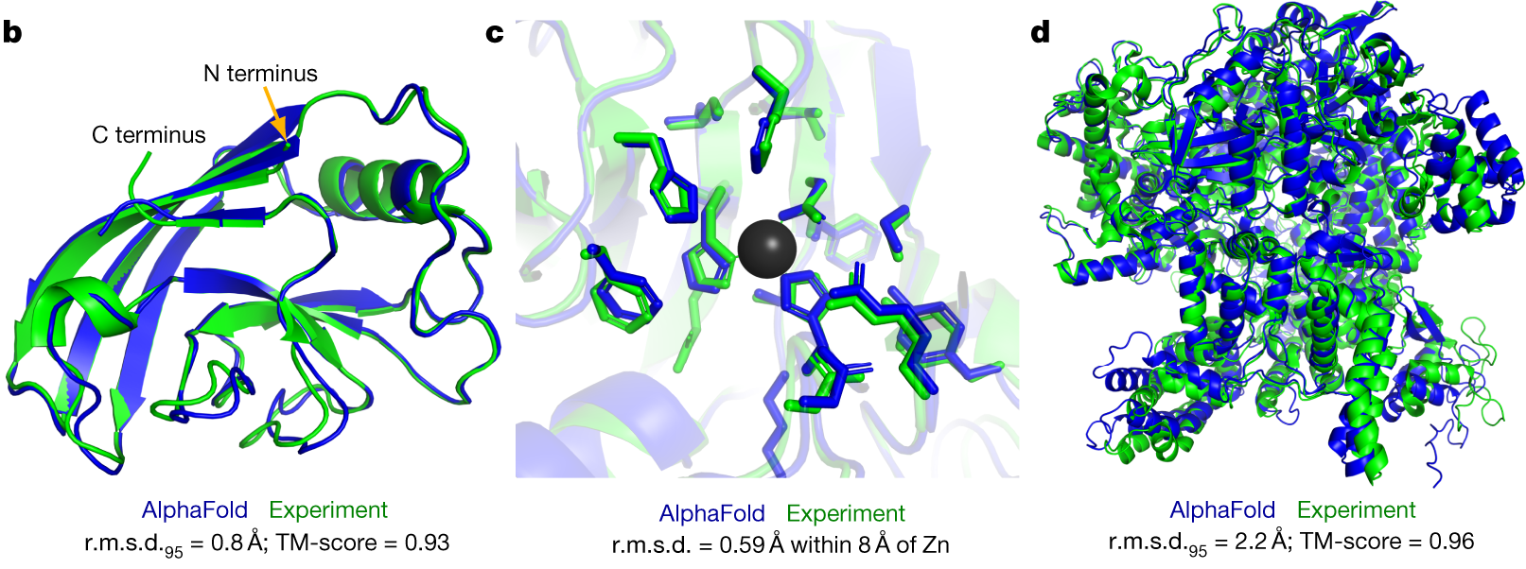

Slide 27
Year | CASP | Winner | GDT Score | Method
1994 | CASP1 | Rost & Sander | 47.0 | Threading
1996 | CASP2 | Jones | 53.8 | Threading
1998 | CASP3 | Jones & McGuffin | 58.9 | Threading
2000 | CASP4 | Baker & Rost | 60.5 | Threading
2002 | CASP5 | Baker & Rost | 61.9 | Threading
2004 | CASP6 | Baker & Rost | 62.7 | Threading
2006 | CASP7 | Baker & Rost | 63.8 | Threading
2008 | CASP8 | Zhang & Baker et al | 66.1 - 67.9 | Threading, Ab initio, Comparative modeling, Template-based modeling, Free modeling
2010 | CASP9 | Zhang Server (Zhang) et al | 68.1 - 69.5 | Ab initio, Comparative modeling, Template-based modeling, Free modeling, Meta server, Refinement
2012 | CASP10 | Zhang Server(Zhang) et al | 69.7 - 71.4 | Ab initio, Comparative modeling, Template-based modeling, Free modeling, Meta server, Refinement
2014 | CASP11 | Zhang Server(Zhang) et al | 70.3 - 72.1 | Ab initio, Comparative modeling, Template-based modeling, Free modeling, Meta server, Refinement
2016 | CASP12 | Zhang Server(Zhang) et al | 71.5 - 73.4 | Ab initio, Comparative modeling, Template-based modeling, Free modeling, Meta server, Refinement
2018 | CASP13 | AlphaFold (DeepMind) | 72.6 - 74.9 | Deep learning
2020 | CASP14 | AlphaFold2 (DeepMind) | 87.0 - 92.4 | Deep learning
Critical Assessment of Protein Structure Prediction (CASP)
The participants are given the amino acid sequences for a set of around 100 proteins
The proteins are not yet published
Each prediction receives a score from 0 to 100
90 is considered of experimental quality
Alphafold in 2018 ~ 70
Alphafold in 2020 = 92.4

Slide 28

History
Alan Turing publishes “Computing Machinery and Intelligence”
First neural network for computers the Perceptron, by Frank Rosenblatt
The first computer-controlled autonomous vehicle, Stanford Cart, was built
The Machine Learning software library Torch is first released
DeepMind’s AlphaFold solved the protein-folding problem
1950
1952
1957
1967
1979
1997
2002
2016
2020
2022
The first program for playing checkers, written by Arthur Samuel
The nearest Neighbor algorithm was written by the Chinese
IBM’s Deep Blue became the first computer chess-playing system to beat a reigning world chess champion, Garry Kasparov
Google’s AlphaGo defeated Lee Sedol, one of the best Go players in the world, in a five-game match
OpenAI’s ChatGPT became a conversational AI system that can interact with humans

Slide 29
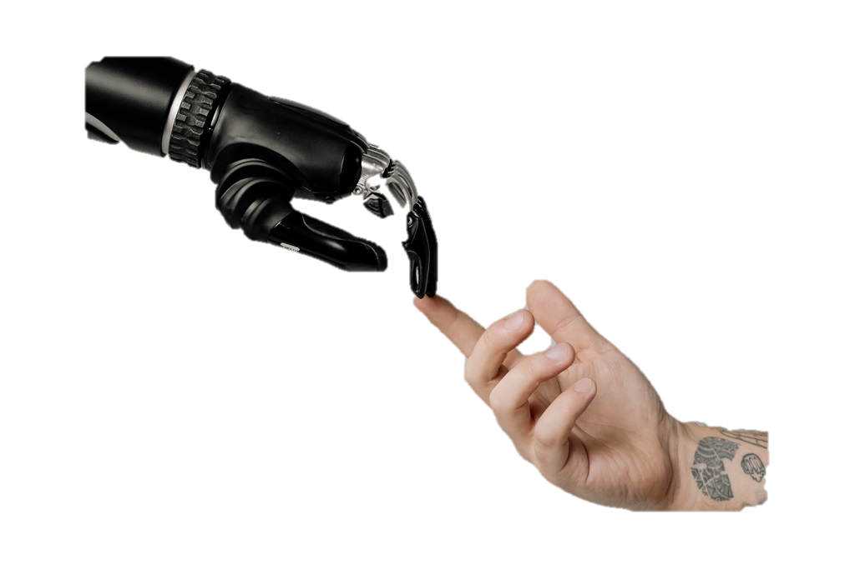
Large Language Models (LLM)
Positive aspects:
High level reasoning and logic: ChatGPT is capable of understanding complex concepts and providing logical responses.
Idiom/language independent: ChatGPT can understand and generate text in multiple languages, making it accessible to a wide range of users.
Writing capabilities mostly indistinguishable from a human being: ChatGPT’s responses are often difficult to distinguish from those written by a human, making it a powerful tool for generating natural-sounding text.
Recent iterations have access to plugins: Recent versions of ChatGPT have access to plugins that can enhance its capabilities, such as providing more detailed information or generating images.
Negative aspects:
Limited knowledge: ChatGPT’s knowledge is limited to the data it was trained on, which means it may not always have the most up-to-date information.
Potential for bias: Like all machine learning models, ChatGPT can exhibit bias if the data it was trained on contains bias.
Difficulty with long-term context: ChatGPT can struggle with maintaining long-term context in a conversation, which can lead to inconsistencies in its responses.
Hallucinations!

Slide 30
ChatGPT

Slide 31
ChatGenerative Pre-trained Transformer

Slide 32

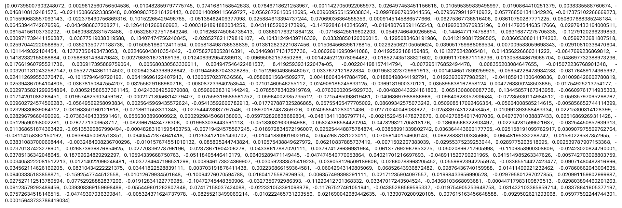
ChatGenerative Pre-trained Transformer
Word vectors
2013
Cat
Notes:
300 numbers long

Slide 33
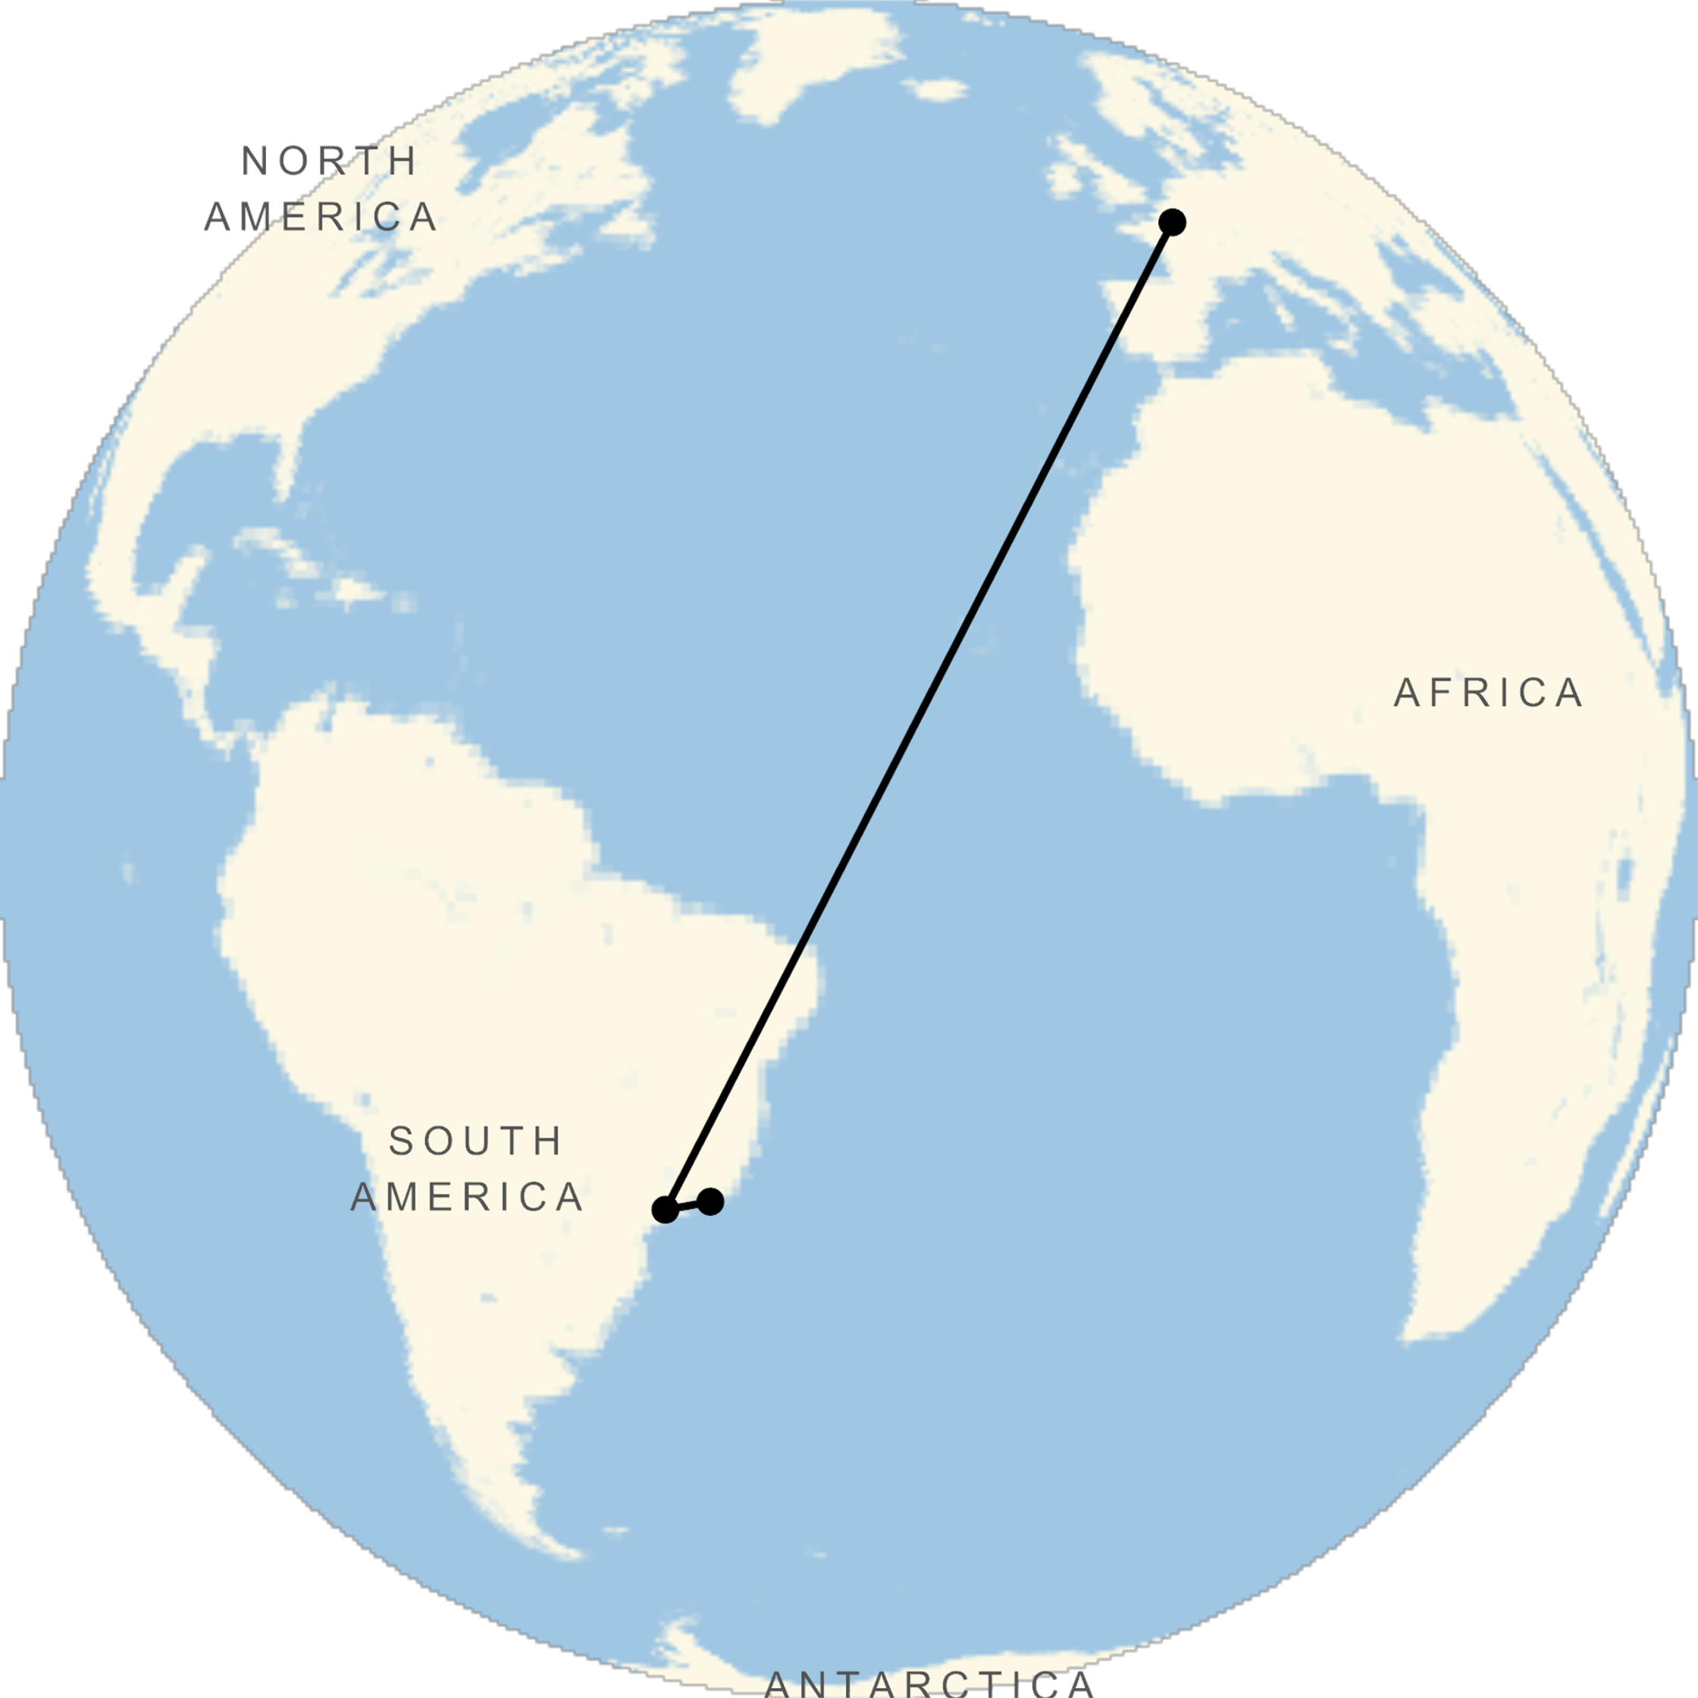
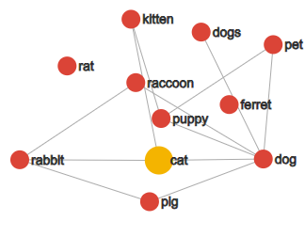
ChatGenerative Pre-trained Transformer
Word vectors
2013
Cat
Rio de Janeiro: [-22.908333, -43.196388]
São Paulo: [-23.533773, -46.625290]
Paris: [48.864716, 2.349014]

Slide 34
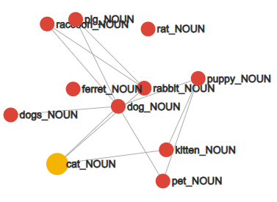
ChatGenerative Pre-trained Transformer
Word vectors
2013
Cat
Rio de Janeiro: [-22.908333, -43.196388]
São Paulo: [-23.533773, -46.625290]
Paris: [48.864716, 2.349014]
Swiss is to Switzerland as Italian is to Italy (nationalities)
Paris is to France as Berlin is to Germany (capitals)
Unethical is to ethical as possibly is to impossibly (opposites)
Mouse is to mice as dollar is to dollars (plurals)
Man is to woman as king is to queen (gender roles)

Slide 35
ChatGenerative Pre-trained Transformer
Word vectors
2013
Cat
Rio de Janeiro: [-22.908333, -43.196388]
São Paulo: [-23.533773, -46.625290]
Paris: [48.864716, 2.349014]
Swiss is to Switzerland as Cambodian is to Cambodia (nationalities)
Paris is to France as Berlin is to Germany (capitals)
Unethical is to ethical as possibly is to impossibly (opposites)
Mouse is to mice as dollar is to dollars (plurals)
Man is to woman as king is to queen (gender roles)
Biggest – Big + Small =
Smallest
Doctor – Man + Woman =
Nurse

Slide 36
'AI drift'
ChatGenerative Pre-trained Transformer
Word vectors
2013
Cat
Rio de Janeiro: [-22.908333, -43.196388]
São Paulo: [-23.533773, -46.625290]
Paris: [48.864716, 2.349014]
She was fine with paying the fine for parking in the wrong spot.
He had a big smile on his face when he saw the face of the clock.

Slide 37
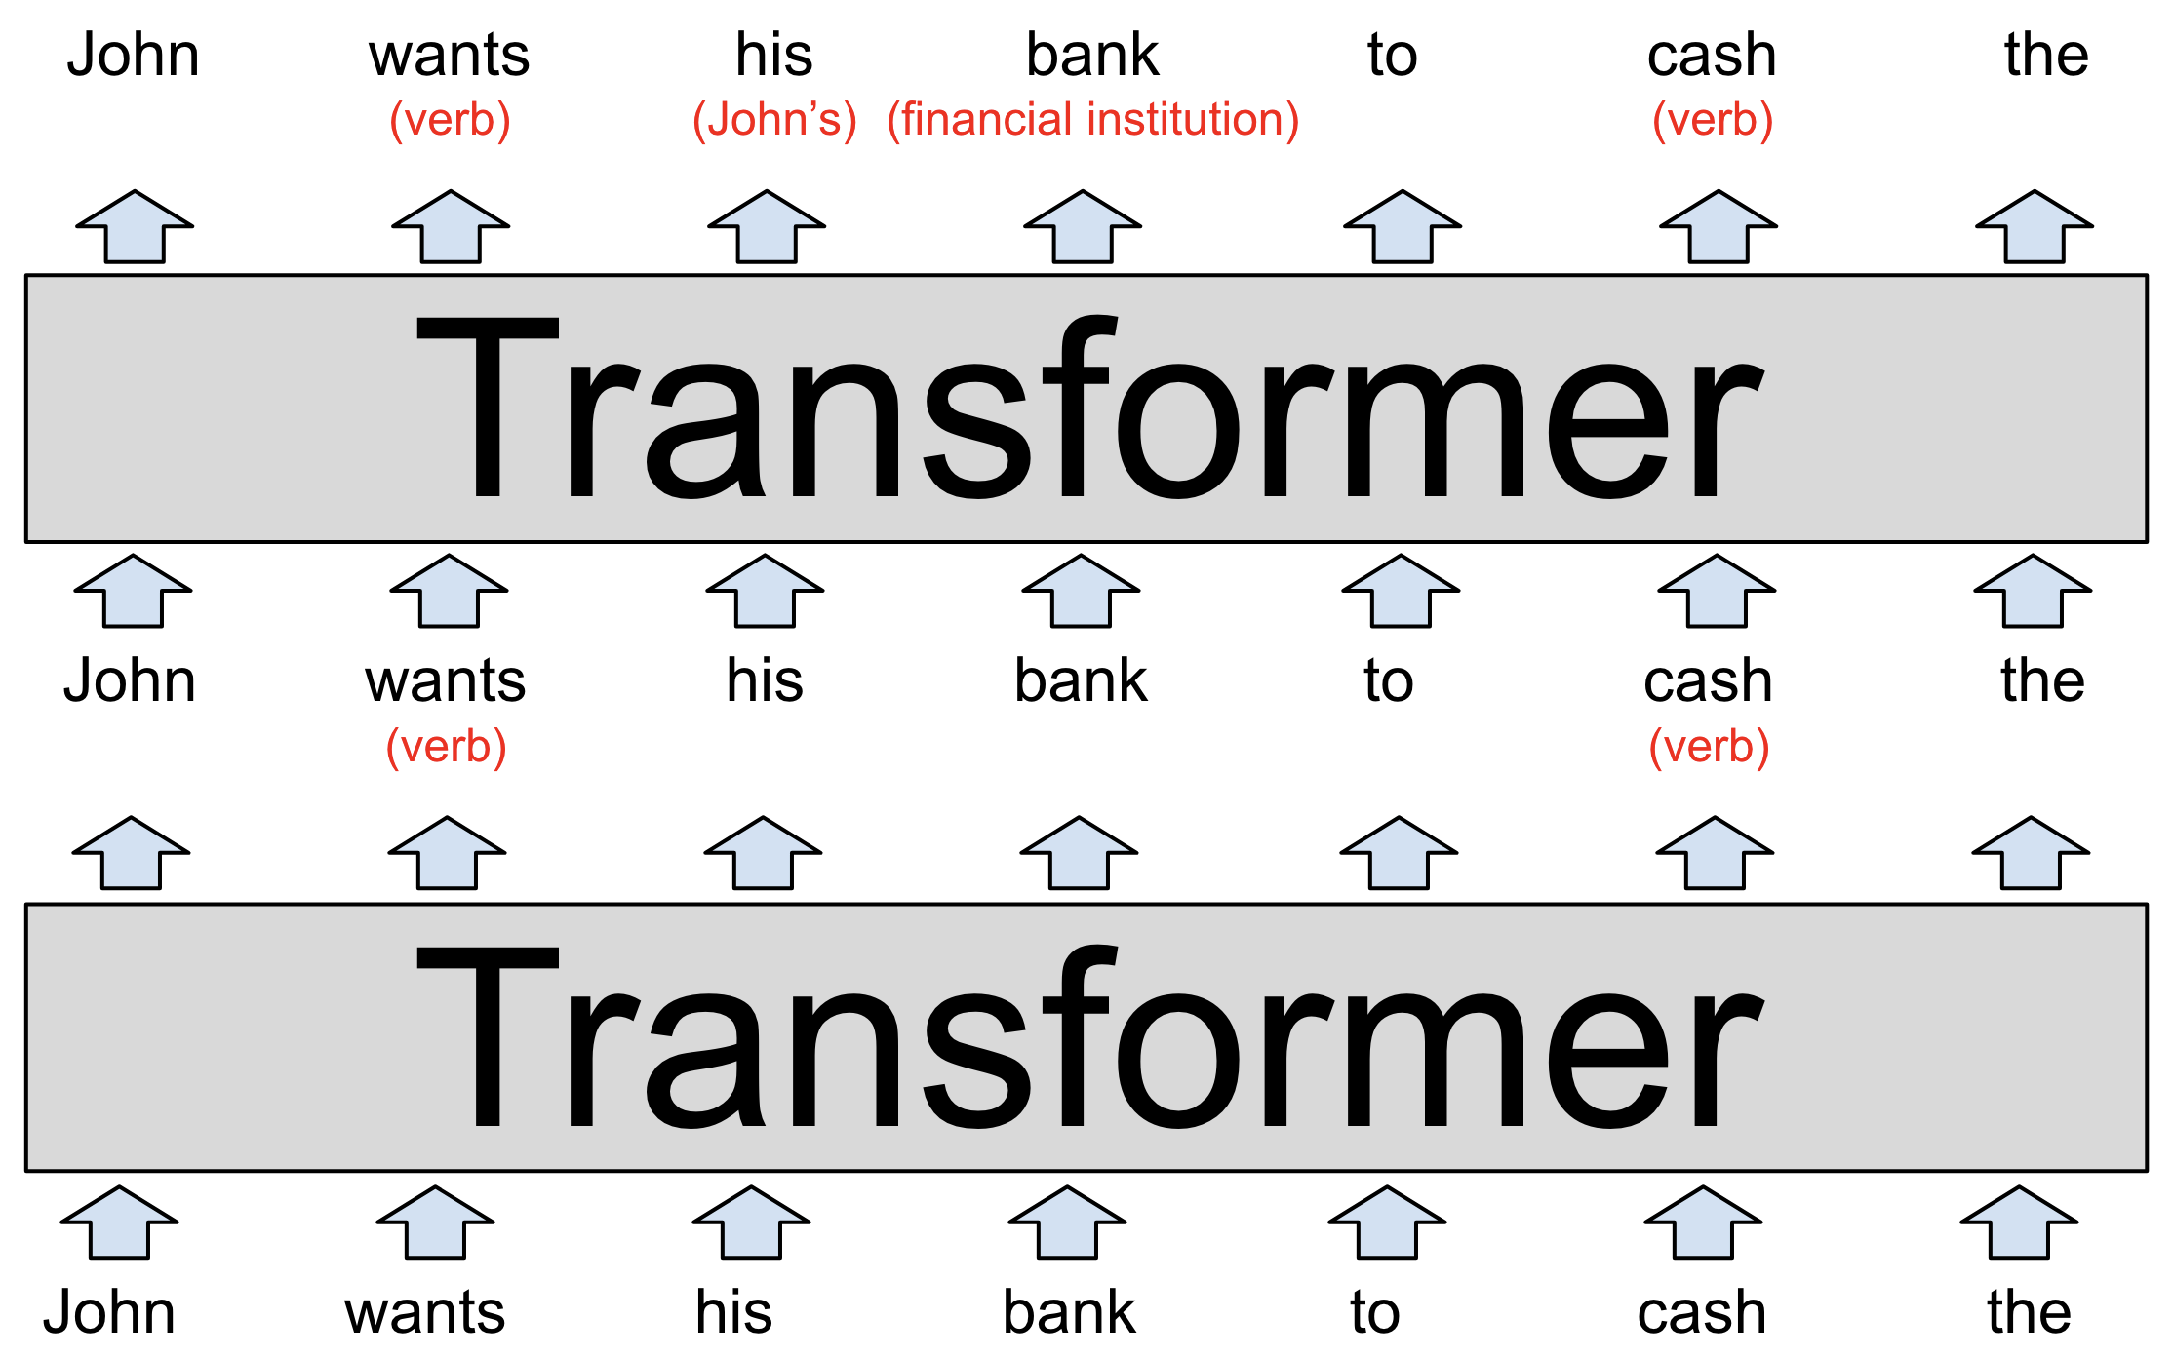
ChatGenerative Pre-trained Transformer
Notes:
GPT3 – 96 layers, each word is a 12,288 dimention vector

Slide 38
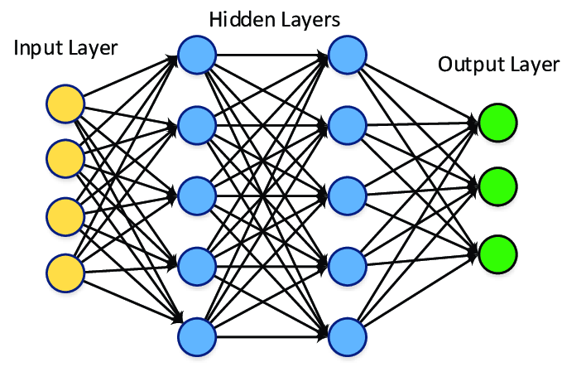
ChatGenerative Pre-trained Transformer
Word vector dimension: 12288
Layers: 96
Parameters: 175 B
Dataset: 500 B
Notes:
GPT3 – 96 layers, each word is a 12,288 dimention vector

Slide 39
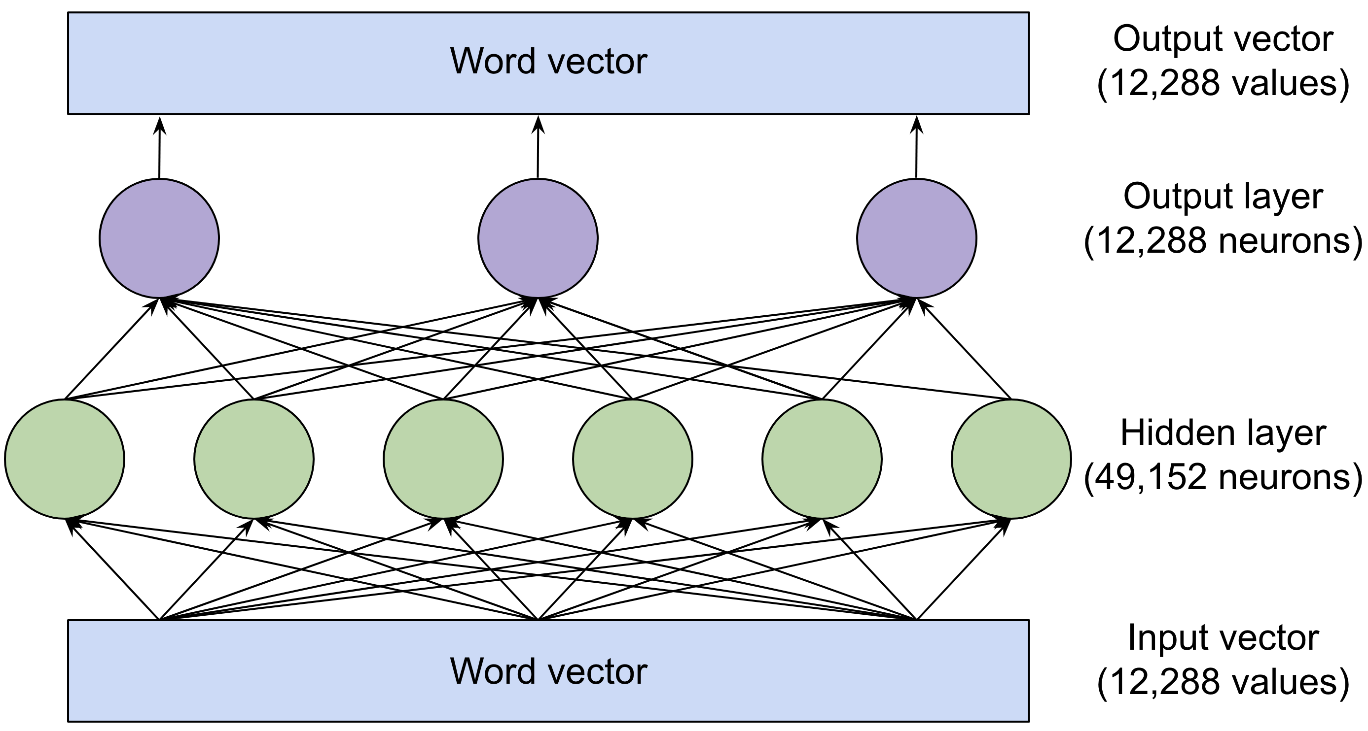
ChatGenerative Pre-trained Transformer
Word vector dimension: 12288
Layers: 96
Parameters: 175 B
Dataset: 500 B
Notes:
GPT3 – 96 layers, each word is a 12,288 dimention vector

Slide 40

In Python…

Slide 41
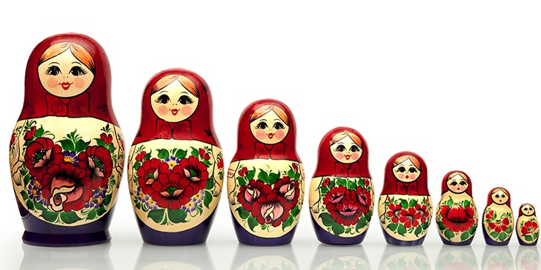
AI x ML x DL

Slide 42
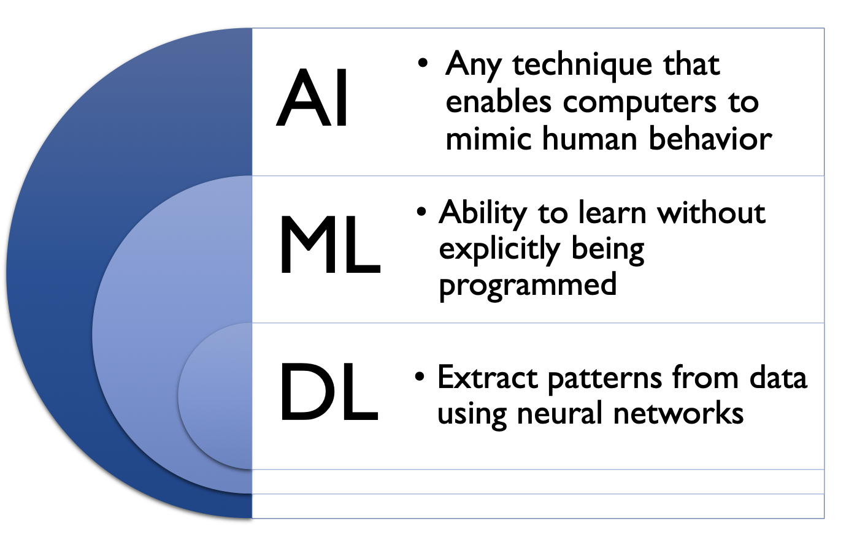

Slide 43
Traditional Programming
Data
Computer
Output
Program
Machine Learning
Data
Computer
Program
Output

Slide 44
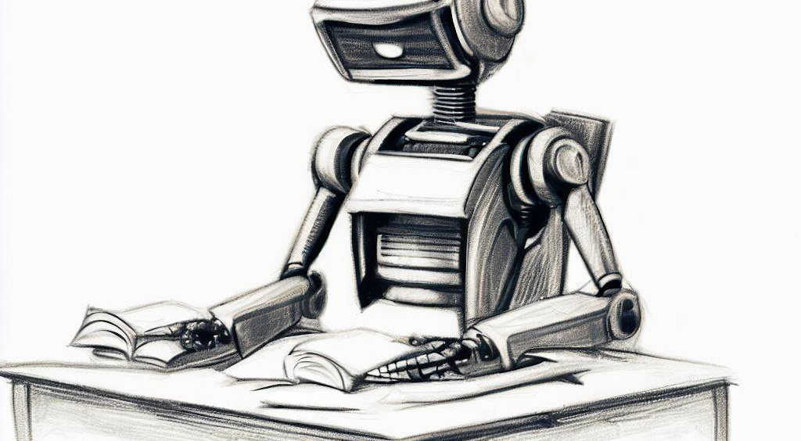
Types of learning

Slide 45

Based on the methods and way of learning, machine learning is divided into mainly four types, which are:
Supervised

Slide 46
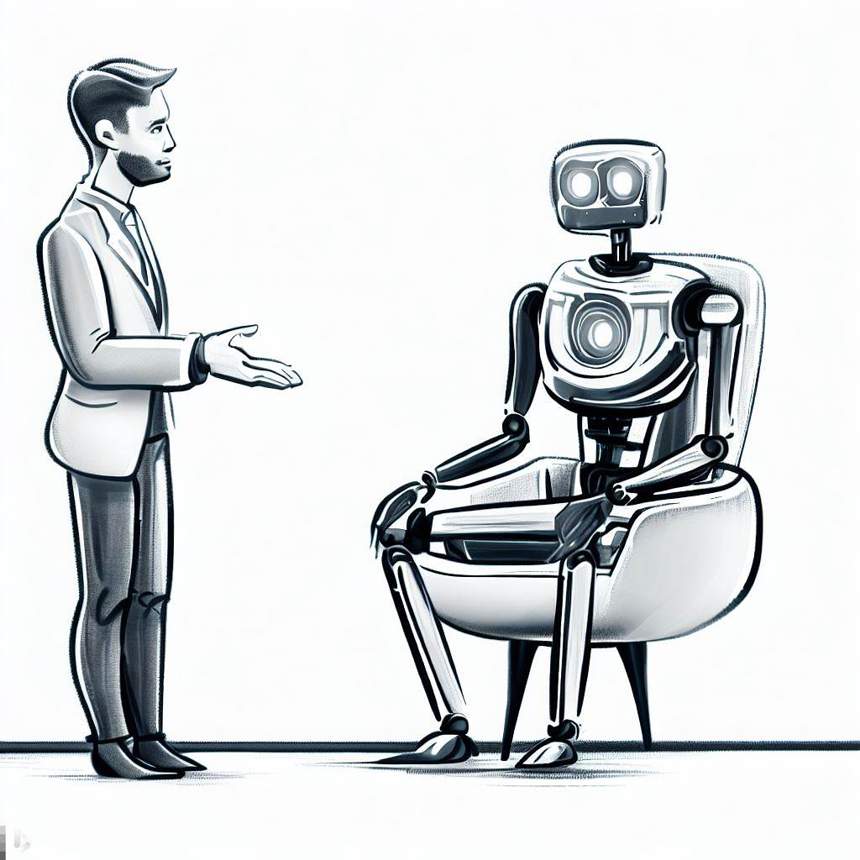
Based on the methods and way of learning, machine learning is divided into mainly four types, which are:
Supervised
In supervised learning, the model is trained on a labeled dataset, which means that each instance in the dataset is paired with the correct output. The goal of supervised learning is to learn a mapping from inputs to outputs.
Linear Regression: Predicting the melting point of a substance based on features like molecular weight, bond types, and polarity.
Logistic Regression: Predicting whether a chemical reaction will occur or not based on reactant properties such as electronegativity difference, reactivity, and concentration.
Decision Trees and Random Forests: Predicting the solubility of a molecule in a particular solvent. Features can include molecular size, charge distribution, and the presence of specific functional groups.
Support Vector Machines (SVM): Classifying molecules as conductive or non-conductive based on features such as bond length, electron mobility, and spatial configuration.
Neural Networks: Predicting molecular properties or activity based on molecular structure. For instance, predicting biological activity of molecules in drug discovery based on their molecular fingerprints.

Slide 47
In Python…

Slide 48
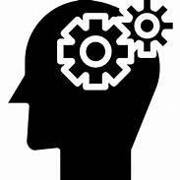
Based on the methods and way of learning, machine learning is divided into mainly four types, which are:
Supervised
Unsupervised

Slide 49
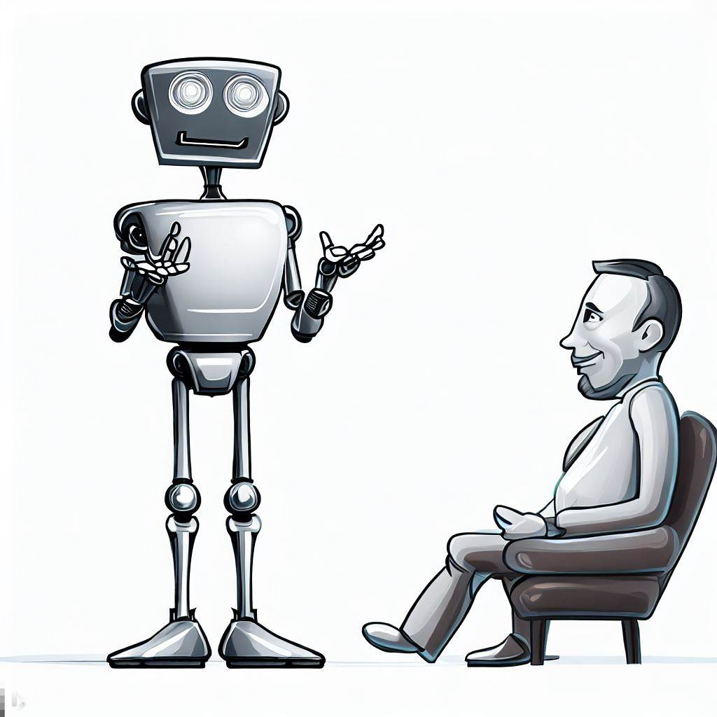
Based on the methods and way of learning, machine learning is divided into mainly four types, which are:
Unsupervised
In unsupervised learning, the model is trained on an unlabeled dataset, trying to find patterns or relationships in the data without specific guidance on what to look for.
Clustering Algorithms:
K-Means: Segmenting different types of molecules based on properties like polarity, acidity, or reactivity.
Hierarchical Clustering: Grouping similar chemical compounds based on hierarchical structural features, from basic functional groups to more complex molecular patterns.
Dimensionality Reduction Algorithms:
Principal Component Analysis (PCA): Reducing the dimensionality of spectral data (like NMR, MS, or IR spectra) to highlight the most significant features, aiding in compound identification or elucidating underlying patterns in chemical datasets.
Generative Adversarial Networks (GANs): Designing new, synthetic molecular structures that are predicted to have desired properties (e.g., drug-like properties) based on training with known chemical compounds.

Slide 50
In Python…

Slide 51
Based on the methods and way of learning, machine learning is divided into mainly four types, which are:
Supervised
Unsupervised

Slide 52

Based on the methods and way of learning, machine learning is divided into mainly four types, which are:
Supervised
Unsupervised
Semi-Supervised

Slide 53
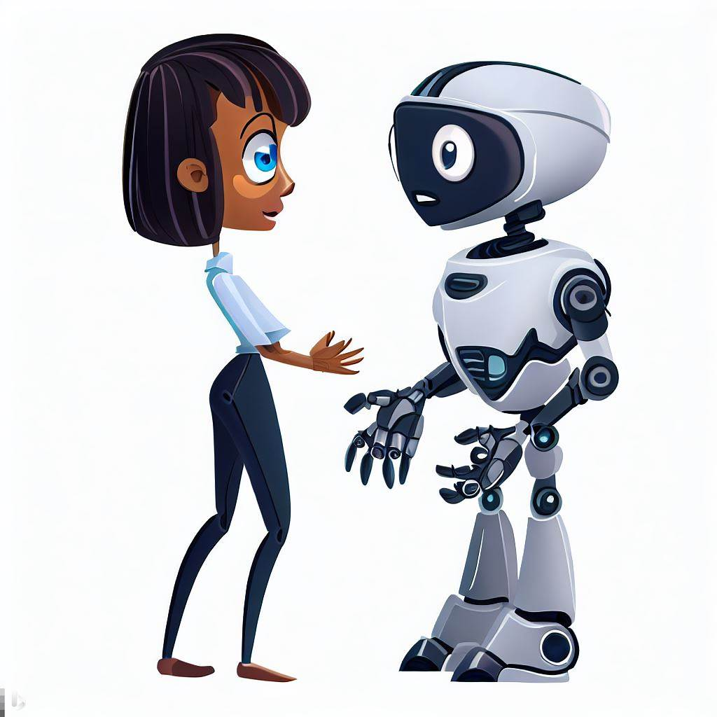
Based on the methods and way of learning, machine learning is divided into mainly four types, which are:
Semi-Supervised
This involves training on both labeled and unlabeled data. It's useful when acquiring labeled data is expensive or time-consuming but unlabeled data is abundant.
Label Spreading and Label Propagation: Algorithms that utilize both molecules with known and unknown activities to disseminate the activity information throughout a compound dataset. This could help in predicting the activity or property of unidentified molecules based on a subset with known characteristics.
Semi-Supervised Support Vector Machines: Used for classifying molecules into categories such as "active" or "inactive" against a specific biological target by leveraging a combination of molecules with established and unknown activities.
Deep Learning with Pseudo-Labeling: Making predictions on the potential reactivity or properties of unlabeled molecules and using these predictions as "pseudo-labels". The model then undergoes training using a mix of molecules with verified properties (actual labels) and these predicted properties (pseudo-labels).

Slide 54

Based on the methods and way of learning, machine learning is divided into mainly four types, which are:
Supervised
Unsupervised
Semi-Supervised
Reinforcement Learning

Slide 55
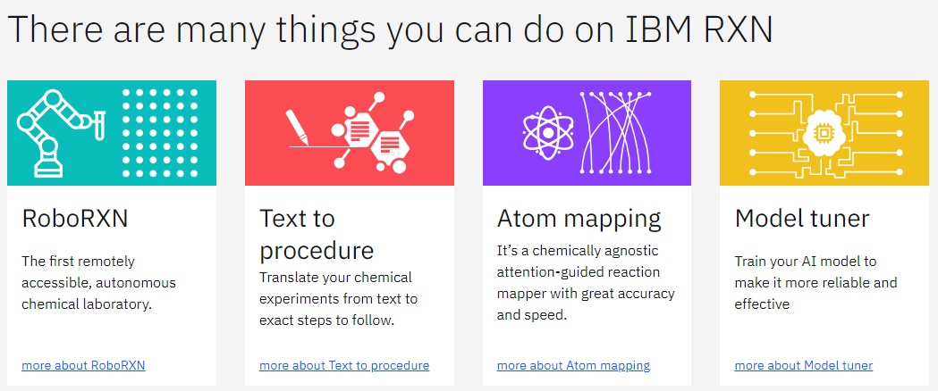
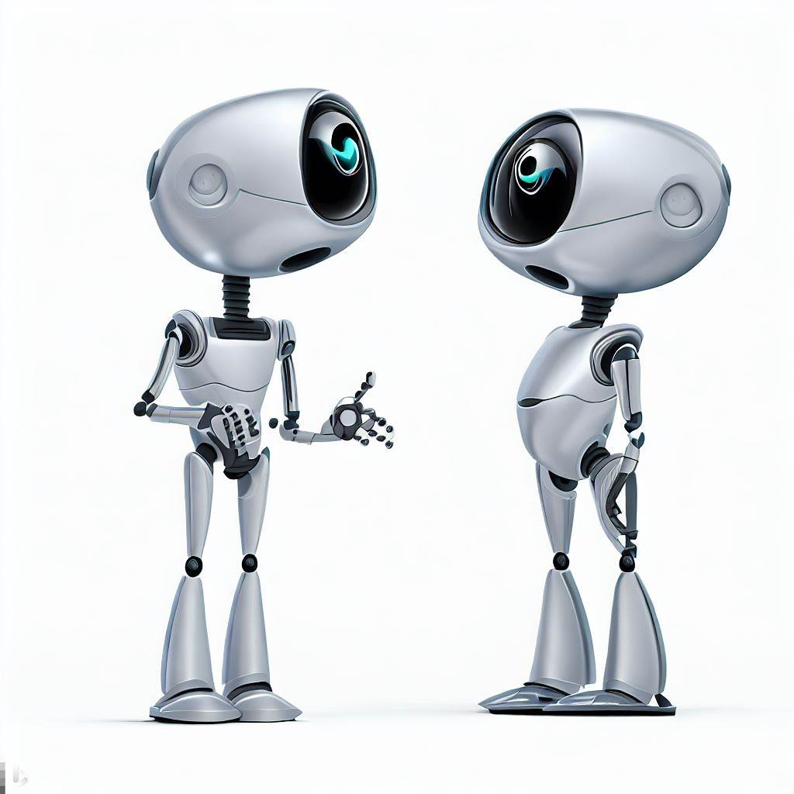
Based on the methods and way of learning, machine learning is divided into mainly four types, which are:
Reinforcement Learning
In reinforcement learning, an agent interacts with an environment and learns to perform actions by receiving rewards or penalties. The goal is to learn a policy that maximizes the expected cumulative reward over time.
Robot Navigation in Chemistry: Directing robotic systems to navigate autonomously within chemical laboratories, managing equipment, and executing experiments independently.
Process Optimization Bots: Dictating when to initiate, halt, or modify chemical processes based on real-time data inputs, such as variations in pH, temperature, or concentration.
https://rxn.app.accelerate.science/

Slide 56
Tomorrow: Molecular Representations and Encodings
SBQT Day 2

